Slide 1
Addition By Abstraction
Jerren Every

Slide 2
About Me
Current Work
Hobbies
Notes:
Currently work with mobile automation, have previously worked with
rest services,
database,
mainframe,
desktop
web.
I currently work for the Enterprise Automation team at Huntington, where we provide automation solutions and support to all of the Huntington business segments.
Hobbies
Camping
Travelling

Slide 3
Ideal Test Framework Attributes
An automation framework should be:
Adaptable
Well Designed
Notes:
Adaptable: able to handle developmental change effectively
Well Designed- designed with the intent of the end user in mind

Slide 4
Adaptable
Orthogonality
DRY(Don’t Repeat Yourself)
Metaprogramming
Refactoring
Notes:
Each of these concepts can be utilized to make code adaptable

Slide 5
Well Designed
TDD(Test Driven Development)
Code Coverage
Dynamic Failures
Data setup and cleanup
Notes:
Each of the concepts can be utilized to ensure code is well-designed.

Slide 6
Adaptable

Slide 7
Orthogonality

Slide 8
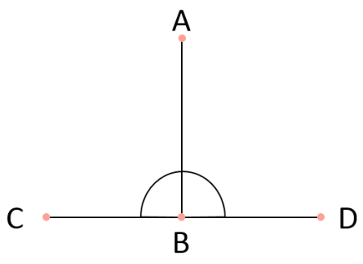
Orthogonality
Orthogonality: Two lines that
Meet at right angles.
Orthogonality Benefits:
Bad code is isolated
Changes are isolated
Easier to unit test
Layer of abstraction between services and code
Notes:
Orthogonality is a term stolen from Geometry, two lines are orthogonal if they meet at right angles. In a programming sense parts of code are orthogonal if changes in one do not impact changes in the other.
Tie back to adaptable:
Easier to Unit Test.
Layer of abstraction makes it easier to troubleshoot.

Slide 9
Orthogonality | Implementation
Cucumber Step Definitions
Helpers
Step Definitions
Helper Methods
Service Being Utilized
Notes:
In Cucumber test suites there is a Step Definition level that drives the test and typically an external service being utilized to interact with the item we are testing.
A Helper is a module that provides functionality to other classes
Changes to the service will not require any changes to step definitions
Step definitions do not have knowledge of the logic that allows them to interact with the item in test.
Examples Where this is Handy:
Any gem interaction within ruby
Web interaction—Watir
Database interaction-
Data modification-separate the logic out so it can be tested

Slide 10
Orthogonality | Example
Step Definitions
Sends Rest request and receives response
Rest Helper
Rest Client Gem
Notes:
Rest Services is a way to send and receive information to an endpoint and in return receive information back or set information.
Step definition which intends to send a rest request
Step definition could house gem interaction information
Gem interaction information is stored in a single helper
Single point of contact with gem

Slide 11
Orthogonality | Constraints
There is a balance that needs struck between complexity and orthogonality; Overly complex orthogonal code can be hard to read and difficult to maintain.
Notes:
Point of balance between being utilized to much and not enough
Has to be determined by each team
Questions?

Slide 12
DRY

Slide 13
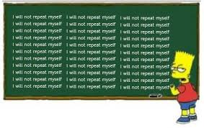
DRY
DRY (Don’t Repeat Yourself):Thought process that logic in programming should not be duplicated.
Benefits of DRY
Notes:
In programming we want to be as lazy as possible, this means that we should take steps so that we do not repeat the same code. If the same logic is utilized twice this logic should be extracted into a method and stored so that it can be reused later on down the road.
Tie back to adaptable:
Forces Restructuring of code as logic has to be moved around to optimize the usage
Changing code is much faster
Issues in code are simpler to fix

Slide 14
DRY | Example 1
The user needs a way to pull login information from a YAML file and login to the application.
The user needs a way to pull transaction input data from a YAML File and fill out a form.
Notes:
Is this a good or bad usage of DRY?

Slide 15
DRY | Example 2
The user needs a way to pull login information from a YAML file and login to the application.
The user needs a way to pull transaction input data from a YAML File and fill out a form.
Notes:
Get data and Fill Field methods are in a reusable abstract state.
Is this a good or bad implementation of dry?
Overlap with DRY and Orthogonality
Difference:
DRY-Logic shouldn’t be duplicated
Orthogonality-other code small point interaction

Slide 16
DRY | How Teams Repeat Themselves
Segmented teams
Illogical storage of logic
Poor communication
Heroism
Code not made abstract enough, refactoring failures
Notes:
Segemented teams- access the same code will solve the same problem different ways without communication
Illogical Storage of Data- Meaningful and agreed upon storage of logic
Poor Communication-updates to a code base aren’t communicated
Heroism- “code person”, hard to modify their code, hard to write your own code.
Code not abstract-abstract out logic when it needs to be utilized multiple time
Additional Examples or questions?

Slide 17
Metaprogramming

Slide 18
Metaprogramming | Definition
Metaprogramming: The process of taking details out of code, utilizing code to write code.
Notes:
Tie back to adaptable: Allows the end user to adapt the usage of the code without having to rewrite the logic.

Slide 19
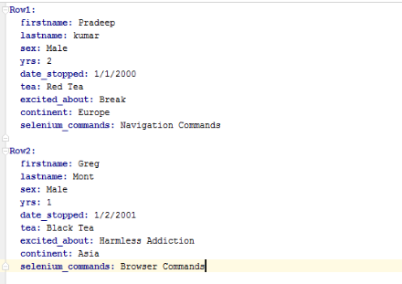
Metaprogramming | YAML
A very good metaprogramming practice is to keep data related information stored in YAML files.
Easier for the User
Easier for the Developer
Notes:
Can keep input data and expected data
YAML metaprogrammed with Faker
User can just change the YAML
Not saying users aren’t technically apt enough
Just simpler
Developers don’t have a lot of code changes committed

Slide 20
Metaprogramming | YAML
Step Definition requests data to fill in the page
Data Helper accesses YAML to get data
Notes:
Step definition(requests data)-> Date Helper(gets data) -> YAML(stores data)
Step definition-is not aware of what data they are utilizing
Step definition is not aware of where the data is
Helpers don’t understand why the data is needed
Helpers don’t understand where the data is utilized
Helper has the raw capability to get the information
YAML – just stores data

Slide 21
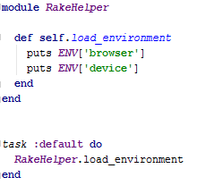
Metaprogramming | Rake
Rake: Ruby Make file
Notes:
A Rake is a ruby make file,
we are able to pass command line arguments into our test suite and then choose how we store those command line arguments.
Simple Rakefile in root directory
Method default task call a method and returns some values
Set variables via command line and then run
You can values are stores

Slide 22
Metaprogramming | Cucumber
Cucumber acts like a metaprogramming tool that can keep details out of code.
Examples include:
Expected/Input Text
Data Keys
Fields Validated
Notes:
Expected/input Text-what I want the application to validate or input
e.g. Given the user logs in as bobsmith
Data Keys-What data I want to extract from YAML to utilize within the application
e.g. Given the user logs in with valid credentials
Fields Validation
e.g. Then the user view the account balance widget.

Slide 23
Metaprogramming | Cucumber Good Example
Gherkin is the syntax that Cucumber utilizes. It follows a given/when/then flow.
Given the user logs in with valid credentials When the user selects account Then the user can see the accounts page
Notes:
Third bullet-
Given-data key and a condition of the test from users perspective
When-action step what our test hinges on
Then-assertion step what we want to validate.

Slide 24
Metaprogramming | Cucumber Bad Example
Given the user logs into the test environment with valid credentials And the user waits for 5 seconds When the user selects accounts Then the user can see the accounts page containing: |accounts header| |account_balance| |account_transaction|
Notes:
Third bullet-
Given- environment housed within a step, the user would not have knowledge of this.
And- five second wait
Then-Our assertion step is overly detailed as to what validation is occurring.

Slide 25
Metaprogramming | Method Creation
Define Method: Within Ruby we can create methods on the fly with define_method.
Notes:
There are method generators that can create methods on the fly.
Define method in ruby allows the creation of methods when classes are loaded.
These methods can then be called by instantiated objects of the class

Slide 26
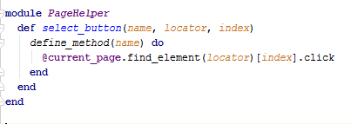
Metaprogramming | Method Creation
Class
Helper Module
Notes:
Explain define method example
Very page object like
Provides concrete code that is customizable by the end user

Slide 27
Metaprogramming | Constraints
Only utilize metaprogramming when it makes sense
Don’t touch constants
Notes:
Each determine what makes sense.
Values that do not change don’t need metaprogrammed
Questions?

Slide 28
Refactoring

Slide 29
Refactoring | Definition
Refactoring: The process of improving the structure of code without changing how the code functions.
Examples from the Refactoring book by Martin Fowler include:
Extract Class
Pull Up
Rename Method/Class
Notes:
Refactoring is the process of improving the structure of code without changing how the actual code functions.
Extract Class -Move parts of existing class into a new class
Pull Up - Move logic to a superclass
Rename Method/Class - Change method/class names to accurately reveal purpose
Tie back to adaptability-refactoring is the process of changing the structure and organization of code without changing the functionality. This process should be utilized constantly to make a more adaptable suite.

Slide 30
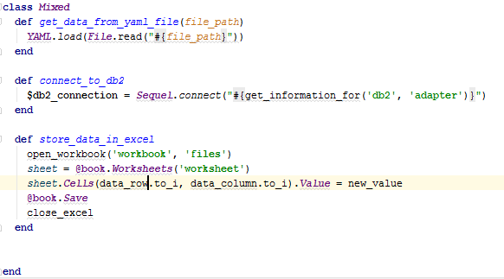
Refactoring | Extract Class
Notes:
One class doing a variety of things
Like Functionalities should be separated out into individual classes

Slide 31
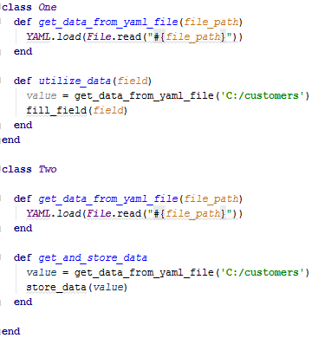
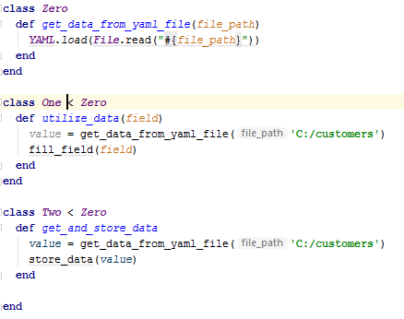
Refactoring | Pull Up
Bad Code Good Code
Notes:
Pull similar functionality from each class to superclass
Subclasses can then utilize it.
Could also do this with including a module

Slide 32
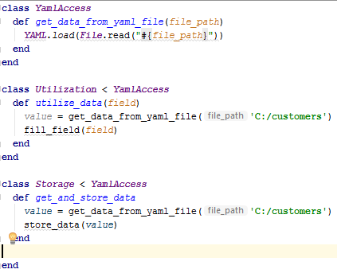
Refactoring | Rename Method/Class
Bad Code Good Code
Notes:
Making class names meaningful

Slide 33
Refactoring | Constraints
Refactoring shouldn’t be forced, it should happen as it provides value
Code ownership
Test Driven Development
Notes:
Happens organically not forced
Defensive People
Culture of Collaboration
TDD environment to validate changes
Software is soft
Questions?

Slide 34
Well Designed

Slide 35
Test Driven Development

Slide 36
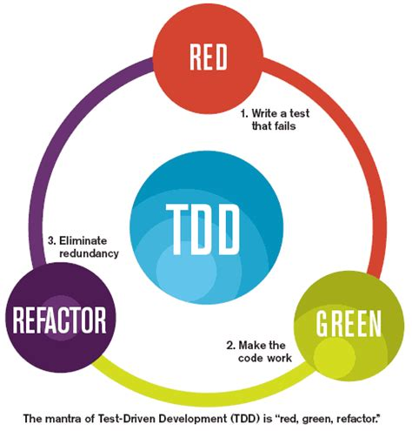
Test Driven Development | Definition
TDD: The process of developing code through testing.
Red, Green, Refactor
Notes:
Test Driven Development is the process of developing code through testing. The benefit being that the software you develop is much more likely to be robust and less error prone. Additionally you have developed unit tests that can be utilized for the life of the functionality you have implemented.
Test Driven Development Steps:
Red-test written it fails when ran
Green-code written test passes or fails
Refactor-modifications to code
Unit tests are very quick ideally.
Tie back to well-designed , well designed code should be tested for criteria set by the end user.

Slide 37
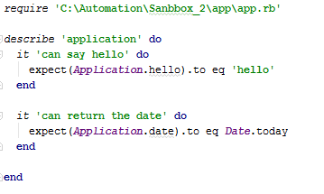
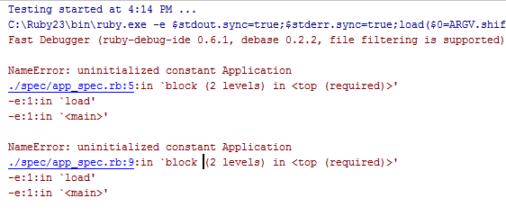
Test Driven Development | Steps Example
Red State
Notes:
Not yet implemented, tests fail
Code has not yet been written.

Slide 38
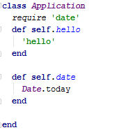
Test Driven Development | Steps Example
Green State
Notes:
Write application code to fulfill Rspec code
There is no guess work in TDD, just bad tests.

Slide 39
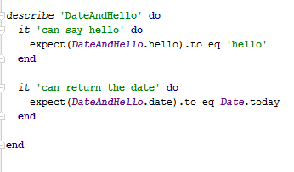
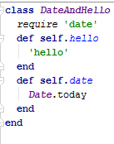
Test Driven Development | Steps Example
Refactor State
Notes:
We then (if we choose) alter our code if we find an issue with it
Class Name has changed from Application to DateAndHello as it is more meaningful
Process should begin with rewriting tests to fail again
Want to make sure tests fail before they are successful

Slide 40
Test Driven Development | Unit Testing and Integration Testing
TDD can be done on two different levels
Unit tests
Integration tests
Notes:
Unit tests- Small Validations
Integration tests – Checks functionality as it operates together
Important to involve the end user in coming up with the requirements for your code.
Utilize Both

Slide 41
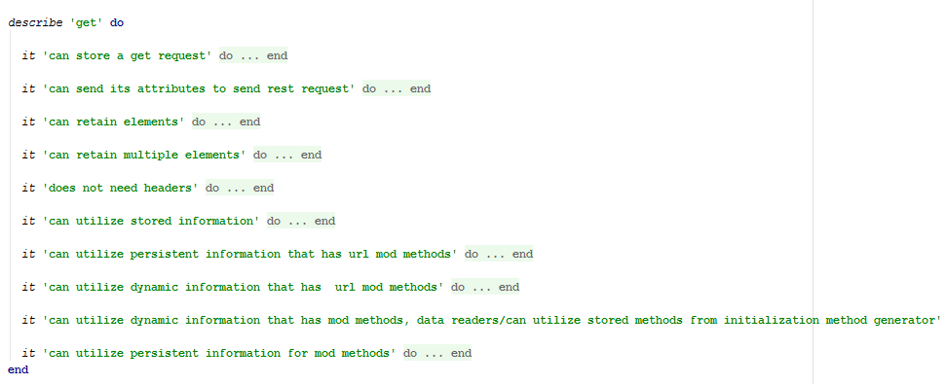
Test Driven Development | Example
TDD Unit Tests
TDD Integration Tests
Notes:
Unit tests on top
Integration tests on bottom

Slide 42
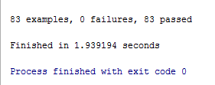
Test Driven Development | Feedback Loop
Speed of tests
Validation of changes
Confidence in changes
Notes:
Fast feedback loop for TDD
Changes can be validated quickly
Confidence in the changes

Slide 43
Test Driven Development | Constraints
TDD Constraints:
Managerial concerns
Time
Quality of tests
Notes:
Managerial concerns about implementation
-Don’t tell them
-show metrics if issues are raised
Time -will take time to implement
Quality-Have to train people to write good tests
Questions?

Slide 44
Code Coverage

Slide 45
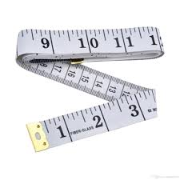
Code Coverage | Definition
Code Coverage: Is a way of measuring the amount of code utilized by a given set of tests.
Notes:
important to know the amount of code being tested.
Tie back to well designed-
We should ensure the code we are writing is tested by our unit tests.

Slide 46
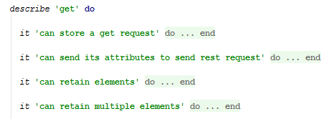
Code Coverage | SimpleCov
Setup
Code
Results

Slide 47
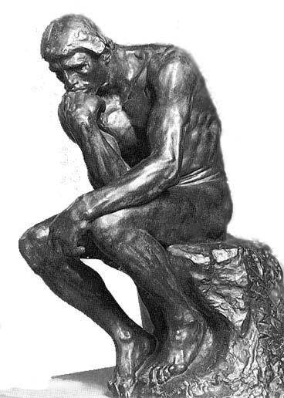
Code Coverage | Constraints
Code Coverage does not mean that code has been tested well
May have valid reasons certain code isn’t tested e.g. getters and setters
Notes:
Questions?

Slide 48
Dynamic Failures

Slide 49
Dynamic Failures | Definition
Dynamic Failures: Developing your code so that if it fails changes are rolled back and the failures are meaningful to the end user.
Notes:
Develop your code to fail as early as possible. Once a failure occurs have code to ensure that steps are completed to roll back any changes made to your environment. Ensure that failures occur in a manner that will direct the developer to the root cause of the issue and tell the end user what failed in the application.
Tie back to well designed-
We should ensure that our tests fail In a meaningful manner.

Slide 50
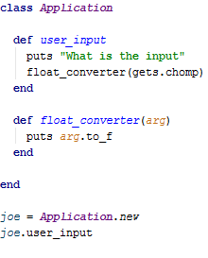
Dynamic Failures | Bad Implementation
Notes:
Our float method accepts whatever the user inputs and attempts to convert it into a float. So issues from user input can cause issues with methods down the line.

Slide 51
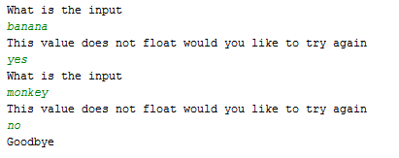
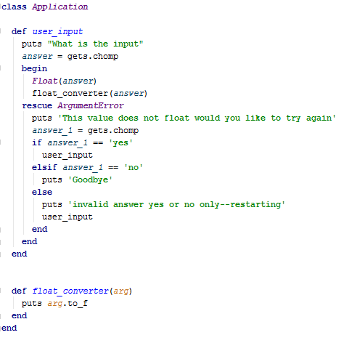
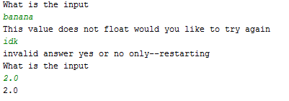
Dynamic Failures | Good Implementation
Notes:
Here our float method checks whether the value is a float and then runs float converter if that is successful otherwise the rescue clause will try to correct the error.

Slide 52
Dynamic Failures | Constraints
Use carefully
Flexibility
Notes:
Rescue clauses should be used carefully.
Let true failures fail tests
Specify the error you are looking for
Don’t make methods to constrained
They will lose flexibility and reusability
Questions?

Slide 53
Data Setup and Cleanup

Slide 54
Data Setup and Cleanup | Definition
Date Setup and Cleanup: The process of setting up and destroying data necessary for a test at run time.
Notes:
Data necessary for a test should (as often as possible) be created and destroyed within the context of a test. The benefits being that each test is receiving clean data, and the test leaves less of a footprint once complete.
Tie back to well-designed
Are tests should leave a minimal negative footprint on the test environment they operate within.

Slide 55
Data Setup and Cleanup | Implementation
Hooks
Ninja Testing
Notes:
Hooks-provide the ability to execute certain functionality before and after a test.
Ninja testing is the process of removing the footprint of your test so that no one can tell that your test ran.

Slide 56
Data Setup and Cleanup | Hooks
Cucumber Hooks:
Before Hooks
After Hooks
Around Hooks
After Step
After Configuration
Notes:
Before Hooks run before each given test that matches their tagging,
after hooks run after.
Around hooks creates a proc that will wrap the test and run before and after it.
After step runs after each step for a given test
After configuration runs after cucumber is configured

Slide 57
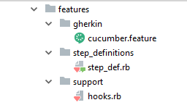
Before Hooks
Directory Structure
Feature File
Hook
Step Definitions
Notes:
Before Hooks Rest Services account origination user creation

Slide 58
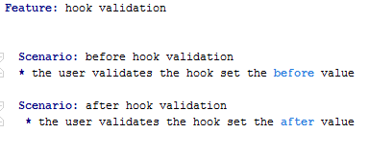
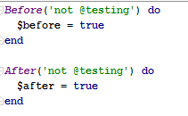
After Hooks
Directory Structure
Feature File
Hook
Step Definitions
Notes:
After hooks to remove account linking in mainframe
Made test data reusable

Slide 59
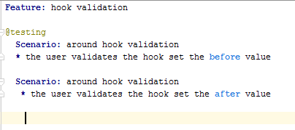
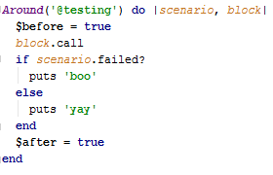
Around Hooks
Directory Structure
Feature File
Hook
Step Definitions
Notes:
Scenario is a cucumber object that houses information from the scenario you are running including test result, test steps, the source and tags
Block is a proc object that represents the code you want to run

Slide 60
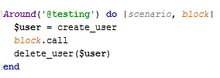
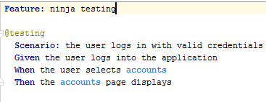
Ninja Testing with Hooks
Hook
Feature File

Slide 61
Data Setup and Cleanup | Constraints
This process of test data setup and tear down is the gold-standard but can become inefficient, this should only be used where it makes sense by improving the quality and efficiency of a given test.
Examples of inefficiency:
Time consuming
Not a reliable process
Not needed
Notes:
Additionally you are adding more liability to your test as far as other things breaking that break your test.
Time Consuming – cleanup taking to long probably not valuable
Not Reliable – if the process doesn’t work don’t utilize it
Not Needed – If the preconditions in the data don’t matter don’t do it
Questions?

Slide 62
Conclusion
In conclusion we have discussed:
Adaptable
Orthogonality
DRY
Metaprogramming
Refactoring
Well-Designed
TDD
Code Coverage
Dynamic Failures
Data Setup and Cleanup
Notes:
Orthogonality-as a way to provide a layer of abstraction between the step definitions that run your tests and the services that support those step definitions.
DRY-as a way to minimize duplication and the ideology that the team owns the code not the individual
Metaprogramming as a way to remove details from our code that would otherwise make our code base brittle.
Refactoring as a process of modifying the structure of our code without modifying the functionality.
TDD as a way to minimize risk when creating and updating test automation software.
Code coverage as a way to ensure our tests are exercising our code
Dynamic/Timely Failures as way to make sure that the developer can quickly identify problem code rather than going down a stack trace goose chase.
Date Setup/Cleanup as a way to maintain robust tests that require minimal preparation prior to execution.
Questions?

Slide 63
Contact Info
jerren1122@hotmail.com

